Slide 1
UVA 12124
Assemble
Time: 3 seconds
(NWERC 2007, LA 3971)

Slide 2
Problem Descriptions (1/2)
Recently your team noticed that the computer you use to practice for programming contests is not good enough anymore.
Therefore, you decide to buy a new computer.
To make the ideal computer for your needs, you decide to buy separate components and assemble the computer yourself.
You need to buy exactly one of each type of component.

Slide 3
Problem Descriptions (2/2)
The problem is which components to buy.
As you all know, the quality of a computer is equal to the quality of its weakest component.
Therefore, you want to maximize the quality of the component with the lowest quality, while not exceeding your budget.

Slide 4
Input (1/2)
On the first line one positive number: the number of testcases, at most 100.
After that per testcase:
One line with two integers:
1 ≤ n ≤ 1000, the number of available components and
1 ≤ b ≤ 1000000000, your budget.

Slide 5
Input (2/2)
n lines in the following format:
‘type name price quality’
type is a string with the type of the component
name is a string with the unique name of the component
price is an integer (0 ≤ price ≤ 1000000) which represents the price of the component
quality is an integer (0 ≤ quality ≤ 1000000000) which represents the quality of the component (higher is better).
The strings contain only letters, digits and underscores and have a maximal length of 20 characters.
It will always possible to construct a computer with your budget. ◎◎◎

Slide 6
Output
Per testcase:
One line with one integer: the maximal possible quality.

Slide 7
Sample Input / Output
Number of test case
1
18 800
processor 3500_MHz 66 5
processor 4200_MHz 103 7
processor 5000_MHz 156 9
processor 6000_MHz 219 12
memory 1_GB 35 3
memory 2_GB 88 6
memory 4_GB 170 12
mainbord all_onboard 52 10
harddisk 250_GB 54 10
harddisk 500_FB 99 12
casing midi 36 10
monitor 17_inch 157 5
monitor 19_inch 175 7
monitor 20_inch 210 9
monitor 22_inch 293 12
mouse cordless_optical 18 12
mouse microsoft 30 9
keyboard office 4 10
9
(Number of components) (Your budget)
type name price quality
(higher is better)

Slide 8
Sample Input / Output
1
18 800
processor 3500_MHz 66 5
processor 4200_MHz 103 7
processor 5000_MHz 156 9
processor 6000_MHz 219 12
memory 1_GB 35 3
memory 2_GB 88 6
memory 4_GB 170 12
mainbord all_onboard 52 10
harddisk 250_GB 54 10
harddisk 500_FB 99 12
casing midi 36 10
monitor 17_inch 157 5
monitor 19_inch 175 7
monitor 20_inch 210 9
monitor 22_inch 293 12
mouse cordless_optical 18 12
mouse microsoft 30 9
keyboard office 4 10
v
66+35+52+54+36+157+30+4
= 434 (< 800)
Minimum quality = 3
Delete all components
which quality is less than 3
v
v
v
v
v
v
v

Slide 9
Sample Input / Output
1
18 800
processor 3500_MHz 66 5
processor 4200_MHz 103 7
processor 5000_MHz 156 9
processor 6000_MHz 219 12
memory 1_GB 35 3
memory 2_GB 88 6
memory 4_GB 170 12
mainbord all_onboard 52 10
harddisk 250_GB 54 10
harddisk 500_FB 99 12
casing midi 36 10
monitor 17_inch 157 5
monitor 19_inch 175 7
monitor 20_inch 210 9
monitor 22_inch 293 12
mouse cordless_optical 18 12
mouse microsoft 30 9
keyboard office 4 10
v
66+88+52+54+36+157+30+4
= 487 (< 800)
Minimum quality = 5
Delete all components
which quality is less than 5
v
v
v
v
v
v
v

Slide 10
Sample Input / Output
1
18 800
processor 3500_MHz 66 5
processor 4200_MHz 103 7
processor 5000_MHz 156 9
processor 6000_MHz 219 12
memory 1_GB 35 3
memory 2_GB 88 6
memory 4_GB 170 12
mainbord all_onboard 52 10
harddisk 250_GB 54 10
harddisk 500_FB 99 12
casing midi 36 10
monitor 17_inch 157 5
monitor 19_inch 175 7
monitor 20_inch 210 9
monitor 22_inch 293 12
mouse cordless_optical 18 12
mouse microsoft 30 9
keyboard office 4 10
v
103+88+52+54+36+175+30+4
= 542 (< 800)
Minimum quality = 6
Delete all components
which quality is less than 6
v
v
v
v
v
v
v

Slide 11
Sample Input / Output
1
18 800
processor 3500_MHz 66 5
processor 4200_MHz 103 7
processor 5000_MHz 156 9
processor 6000_MHz 219 12
memory 1_GB 35 3
memory 2_GB 88 6
memory 4_GB 170 12
mainbord all_onboard 52 10
harddisk 250_GB 54 10
harddisk 500_FB 99 12
casing midi 36 10
monitor 17_inch 157 5
monitor 19_inch 175 7
monitor 20_inch 210 9
monitor 22_inch 293 12
mouse cordless_optical 18 12
mouse microsoft 30 9
keyboard office 4 10
v
103+88+52+54+36+175+30+4
= 542 (< 800)
Minimum quality = 7
Delete all components
which quality is less than 7
v
v
v
v
v
v
v

Slide 12
Sample Input / Output
1
18 800
processor 3500_MHz 66 5
processor 4200_MHz 103 7
processor 5000_MHz 156 9
processor 6000_MHz 219 12
memory 1_GB 35 3
memory 2_GB 88 6
memory 4_GB 170 12
mainbord all_onboard 52 10
harddisk 250_GB 54 10
harddisk 500_FB 99 12
casing midi 36 10
monitor 17_inch 157 5
monitor 19_inch 175 7
monitor 20_inch 210 9
monitor 22_inch 293 12
mouse cordless_optical 18 12
mouse microsoft 30 9
keyboard office 4 10
156+170+52+54+36+210+30+4
= 712 (< 800)
Minimum quality = 9
Delete all components
which quality is less than 9
v
v
v
v
v
v
v
v

Slide 13
Sample Input / Output
1
18 800
processor 3500_MHz 66 5
processor 4200_MHz 103 7
processor 5000_MHz 156 9
processor 6000_MHz 219 12
memory 1_GB 35 3
memory 2_GB 88 6
memory 4_GB 170 12
mainbord all_onboard 52 10
harddisk 250_GB 54 10
harddisk 500_FB 99 12
casing midi 36 10
monitor 17_inch 157 5
monitor 19_inch 175 7
monitor 20_inch 210 9
monitor 22_inch 293 12
mouse cordless_optical 18 12
mouse microsoft 30 9
keyboard office 4 10
219+170+52+54+36+293+18+4
= 846 (> 800)
╳ not a solution
So the answer is 9.
v
v
v
v
v
v
v
v

Slide 14
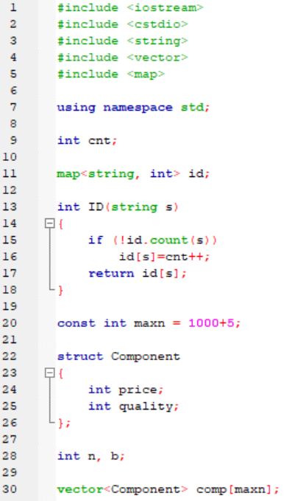

Slide 15
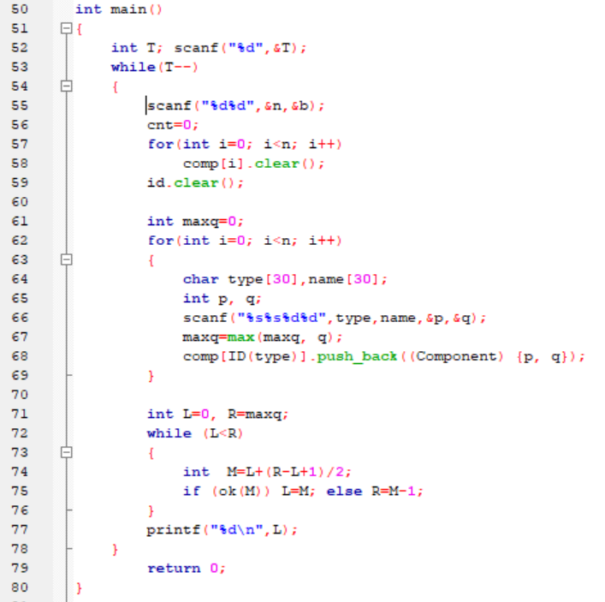

Slide 16
